Slide 1
購物年金的新發展
Shopping Annuity Advancements
Helen Lin
專業經理級 Professional Coordinator
四個佣金週期共賺取HK$34,500
HK$34,500 in 4 Commission weeks
本簡報中提到的收入等級純屬舉例說明，無意代表美安香港超連鎖店主的一般收入，也無意表示任何超連鎖店主皆可賺取同等收入。美安香港超連鎖店主的成功與否，取決於其在發展事業時的努力、才能與投入程度。The income levels mentioned in the following presentation are for illustration purposes only. They are not intended to represent the income of a typical Market Hong Kong UnFranchise Owner, nor are they intended to represent that any given Independent UnFranchise Owner will earn income in that amount. The success of any Market Hong Kong Independent UnFranchise Owner will depend upon the amount of hard work, talent, and dedication which he or she devotes to building his or her Market Hong Kong Business.

Slide 2
什麼是年金 ? What is Annuity?
年金，國外叫Annuity，是定期或不定期的時間內一系列的現金流入或流出
由企業退休金計劃提供的養老金
年金計劃是一種很好的投資安排，年金計劃分為年金合同和國庫券等
A series of payments made at fixed or unfixed intervals of time
Examples of annuities are regular deposits to pension payments
A good investment arrangement, which divided into an annuity contract and bonds

Slide 3
年金 vs 購物年金 Annuity vs Shopping Annuity
在網上選購你想要且需要的商品
顧客從HK.SHOP.COM購物，可享有2% - 25%現金回贈
一個革命性嶄新購物計劃
Purchase what you want and need online
Enjoy 2% - 25% CashBack on HK.SHOP.COM shopping
A revolutionary new shopping plan

Slide 4
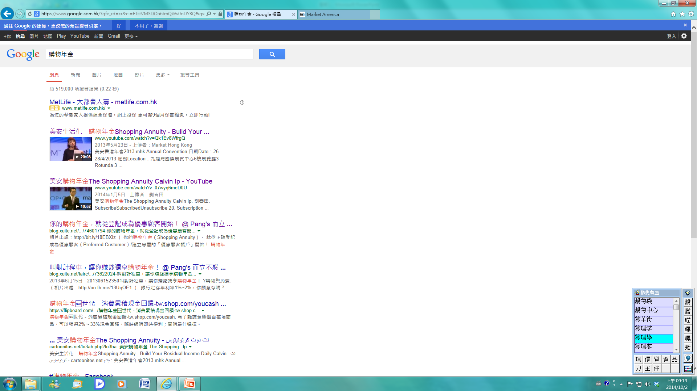
購物年金
Shopping Annuity

Slide 6
轉消費為收入? Convert Spending into earning?

Slide 9
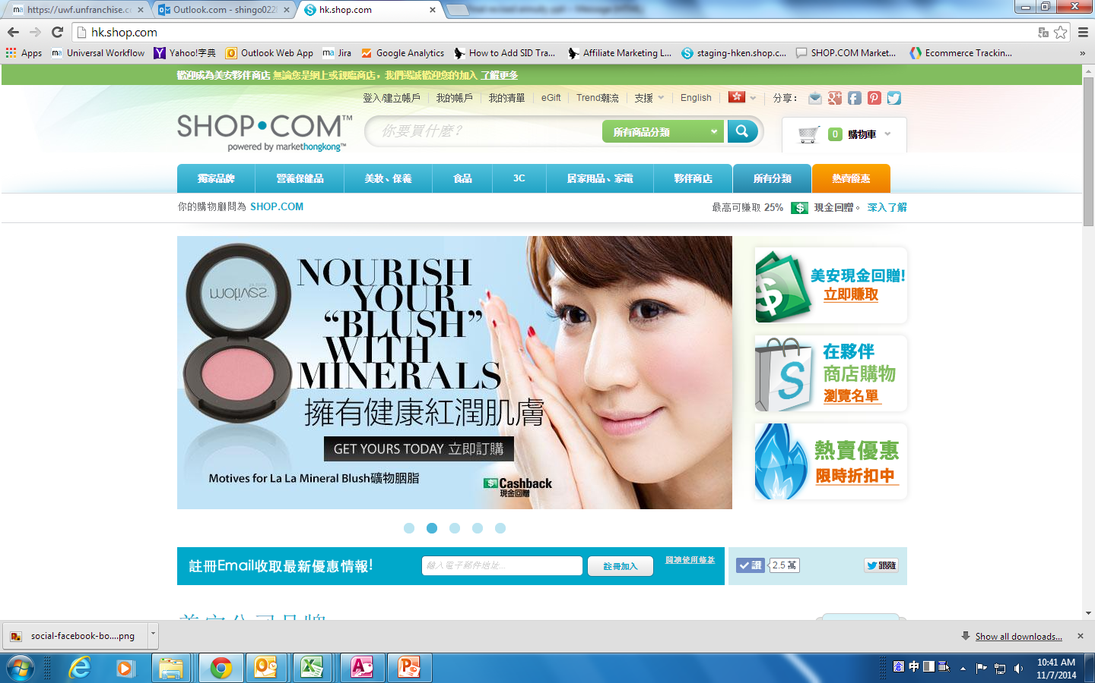

Slide 10
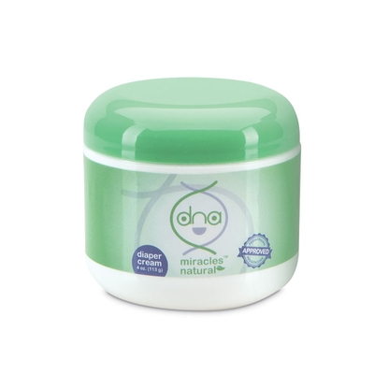
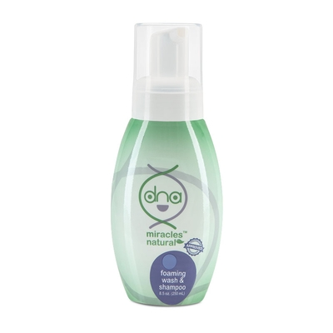
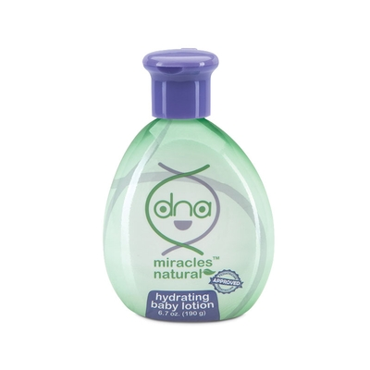
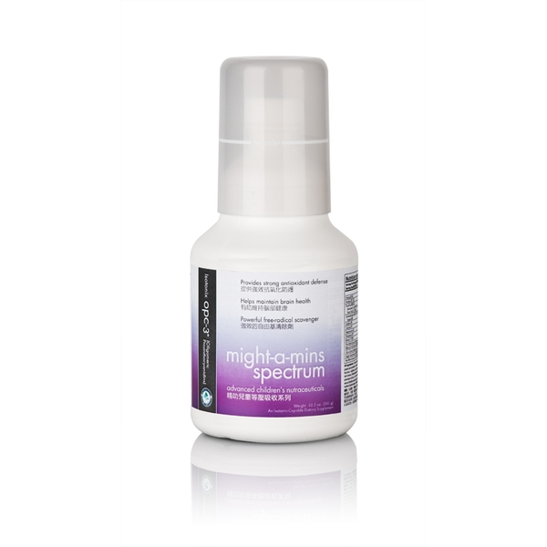
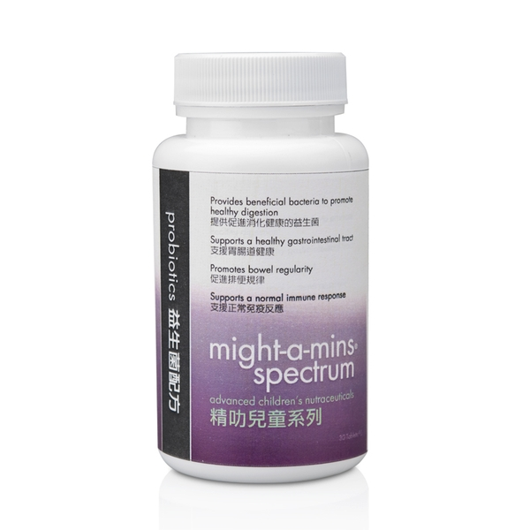
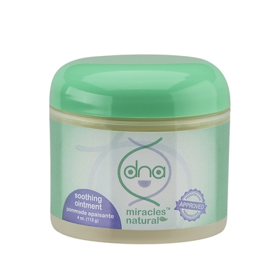
美安獨家代理品牌The MA Exclusive Brands

Slide 11
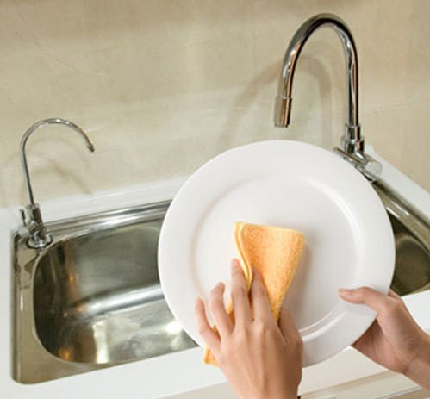
日常生活習慣 Habits

Slide 12
轉換美安獨家代理品牌 Change to the MA exclusive brands

Slide 13
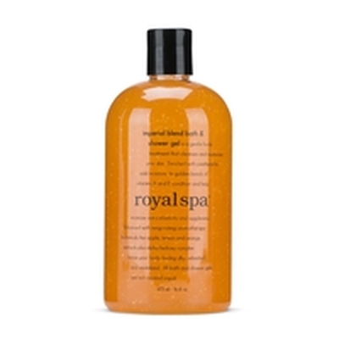
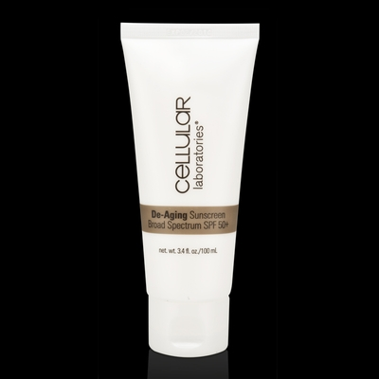
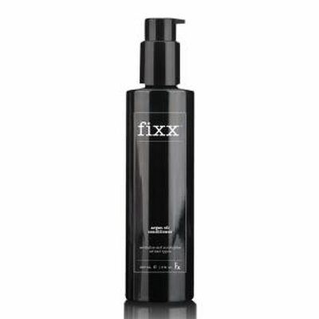
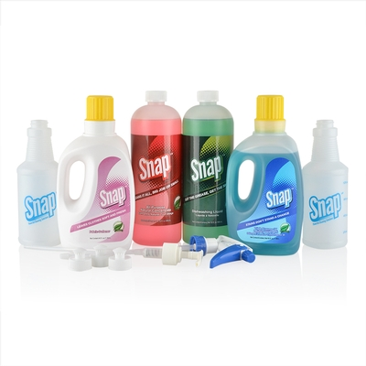
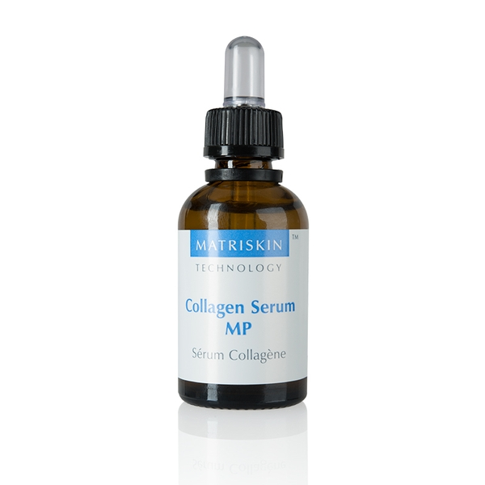
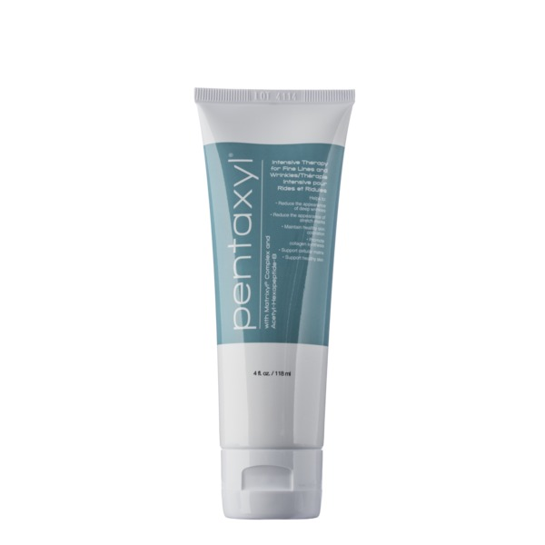
家居及個人護理產品 Home and Garden and personal care products

Slide 14
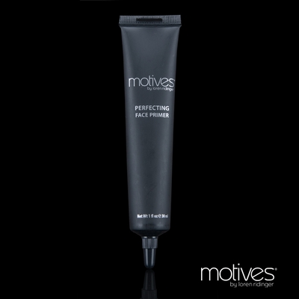
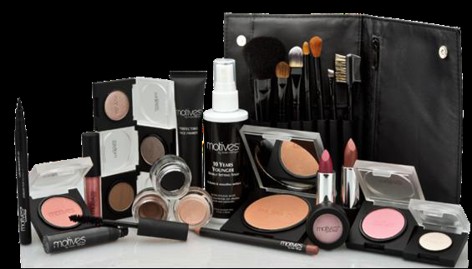
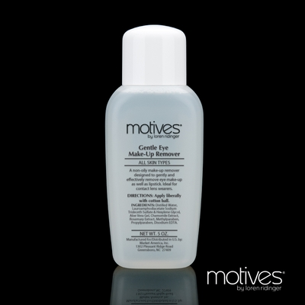
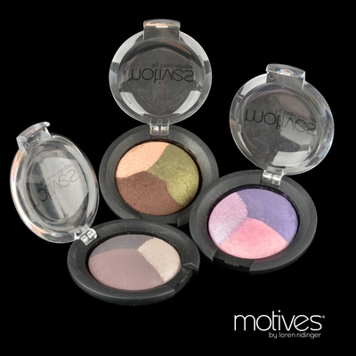
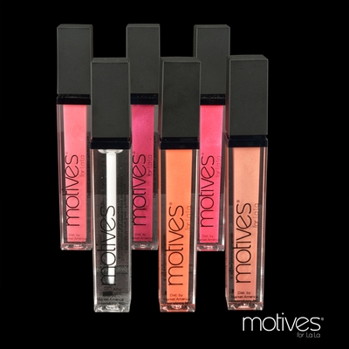
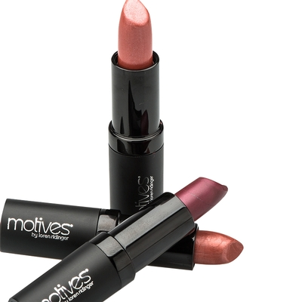
化妝品Cosmetics

Slide 15
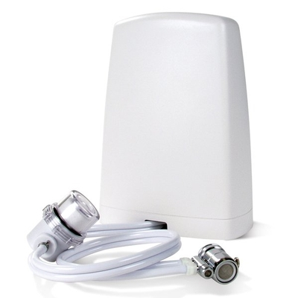
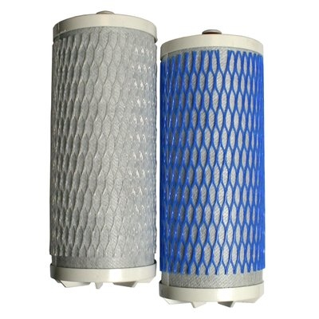
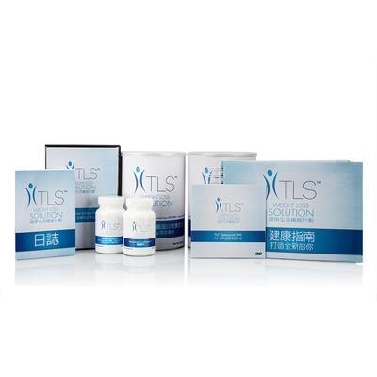
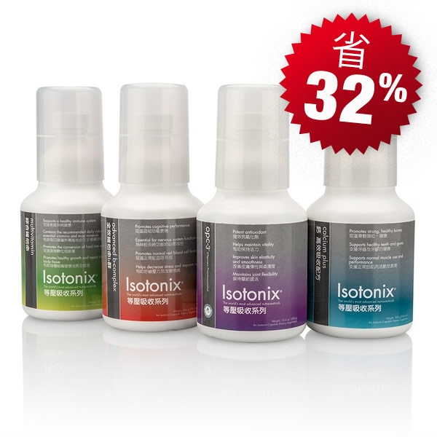
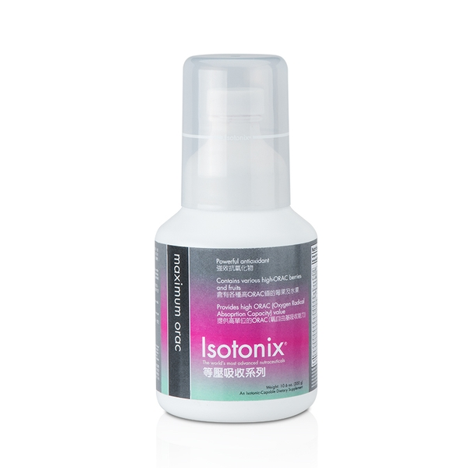
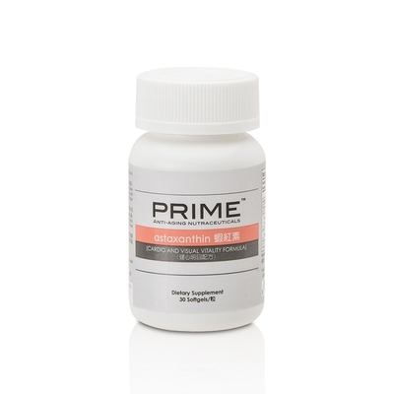
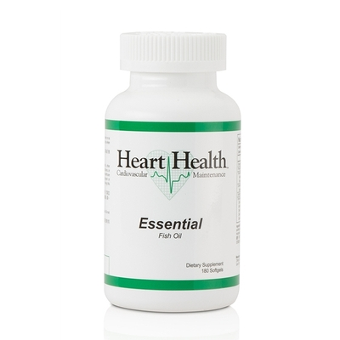
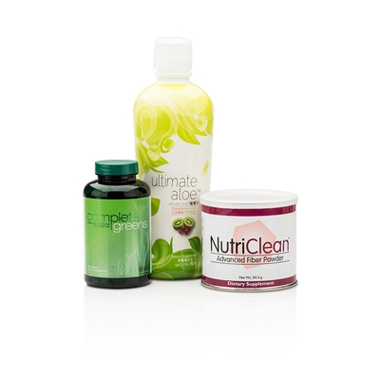
健康營養補充品及濾水器 The health supplements and water filter

Slide 16
美安獨家代理品牌 – 2%現金回贈 The MA Exclusive Brands-2%Cashback
例子1)家居及個人護理產品Home and Garden and personal care products
例子2)健康營養補充品及濾水器The health supplements and water filter
$140 x 2% = $2.8
$168 x 2% = $3.36
$2425 x 2% = $48.5
$1282 x 2% = $25.64
$823 x 2% = $16.46
$1100 x 2% = $22
$830 x 2% = $16.6
$419 x 2% = $8.38

Slide 17
MHK product | Price | Cash Rebate | Year | Cash Rebate
Royal Spa Shower Gel | $140 | $2.80 | x 6 | $16.80
Argan Oil Shampoo | $168 | $3.36 | x 6 | $20.16
Argan Oil Conditioner | $168 | $3.36 | x 6 | $20.16
Skintelligence set | $1,098 | $21.96 | x 4 | $87.84
Pentaxyl | $656 | $13.12 | x 3 | $39.36
Matriskin | $1,282 | $25.64 | x 4 | $102.56
VitaShield Opc Triple Serum | $880 | $17.60 | x 4 | $70.40
Lumiere de Vie | $2,425 | $48.50 | x 4 | $194.00
Cellular SPF 50+ | $230 | $4.60 | x 4 | $18.40
Snap Cleaning Kit | $439 | $8.78 | x 4 | $35.12
Pure H2O | $823 | $16.46 | x 1 | $16.46
Pure H2O Filter | $539 | $10.78 | x 2 | $21.56
Motives Liquie Foundation | $248 | $4.96 | x 6 | $29.76
Primer | $207 | $4.14 | x 6 | $24.84
10 Years Younger | $277 | $5.54 | x 6 | $33.24
Mineral Blush | $139 | $2.78 | x 2 | $5.56
Eye Shadow | $228 | $4.56 | x 3 | $13.68
Mascara | $150 | $3.00 | x 6 | $18.00
Mineral Lip Shine | $175 | $3.50 | x 6 | $21.00
Mineral Lipstick | $155 | $3.10 | x 6 | $18.60
Vit E Lip Treatment | $182 | $3.64 | x 6 | $21.84
Motives Eye Makeup Remover | $124 | $2.48 | x 6 | $14.88
Essential Brow Kit | $292 | $5.84 | x 4 | $23.36
TLS Kit | $1,150 | $23.00 | x 12 | $276.00
Isotonix Daily Kit | $1,100 | $22.00 | x 6 | $132.00
Isotonix ORAC | $656 | $13.10 | x 6 | $78.60
Isotonix Vit C | $293 | $5.86 | x 6 | $35.16
Isotonix Digestive Enzyme | $280 | $5.60 | x 8 | $44.80
Detox Kit | $830 | $16.60 | x 6 | $99.60
Ultimate Aloe | $245 | $4.90 | x 18 | $88.20
Essential Fish Oil | $419 | $8.38 | x 6 | $50.28
蝦紅素 | $332 | $6.64 | x 12 | $79.68
現金回贈 :
每年 $1,751.90
20 歲開始用美安產品:
$1,751.90 x 40年 = $70,076
Annual Cashback :
$1,751.90
Use MA products start from 20 years old :
$1,751.90 x 40yrs = $70,076

Slide 18
夥伴商店
美安夥伴商店 2% - 25%現金回贈
Partner STORES: 2%-25% CaShback
Notes:
18

Slide 19
美安夥伴商店 2% - 25%現金回贈
Partner STORES: 2%-25% CaShback
現金回贈 :
每年 $4,140.00
20 歲開始用美安夥伴商店:
$4,140.00 x 40年 = $165,600.00
Annual Cashback :
$4,140.00
Purchase in Partner Stores start from 20 years old : $4,140.00 x 40yrs = $165,600.00
$80 x 5% x 15日= $ 60
$2,000 x 5% = $100
$100 x 2% x 20日= $40
$1,500 x 3% = $45
$10,000 x 3% = $300
$50 x 5% x 30日= $75

Slide 21
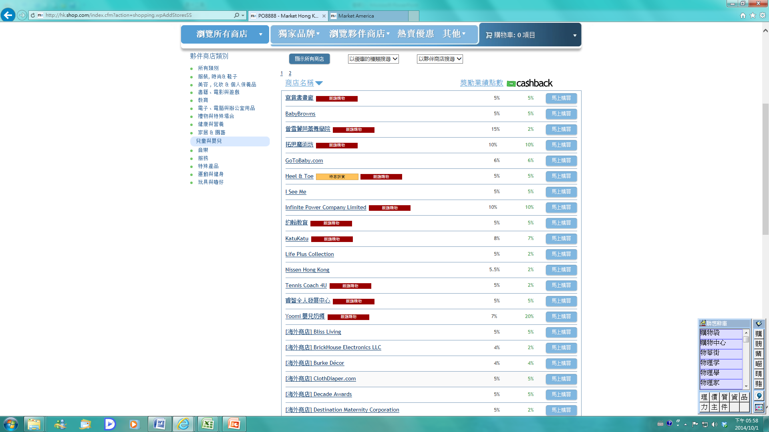
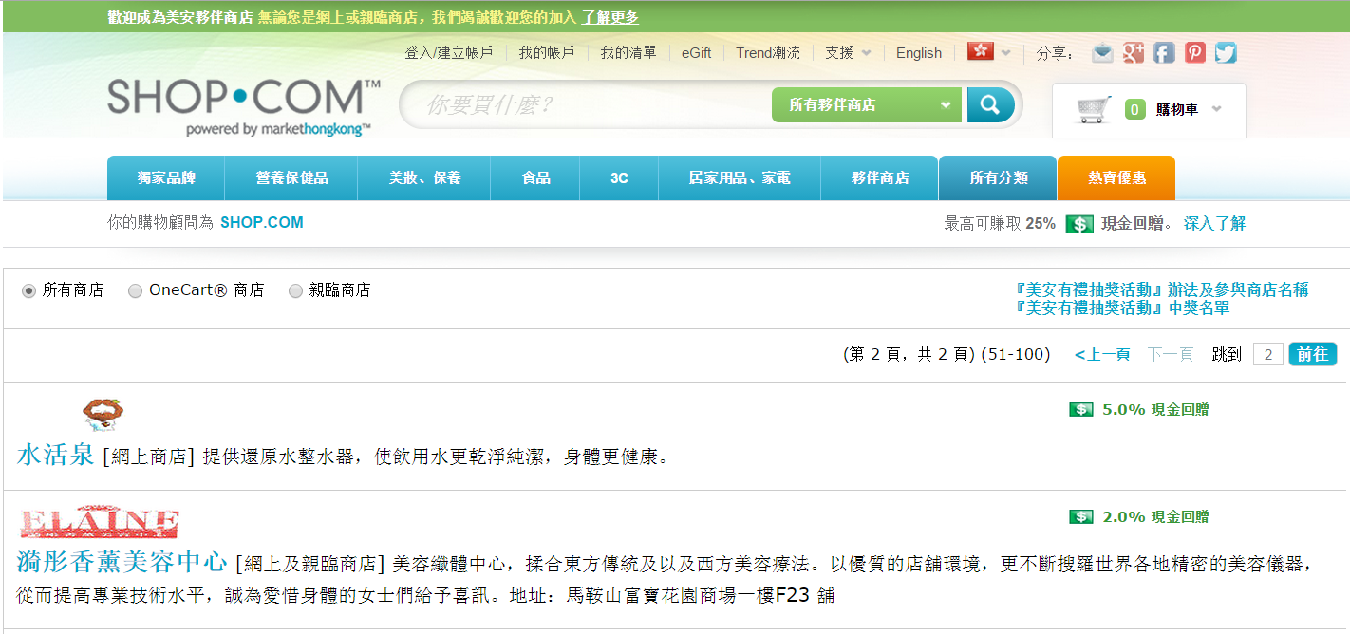
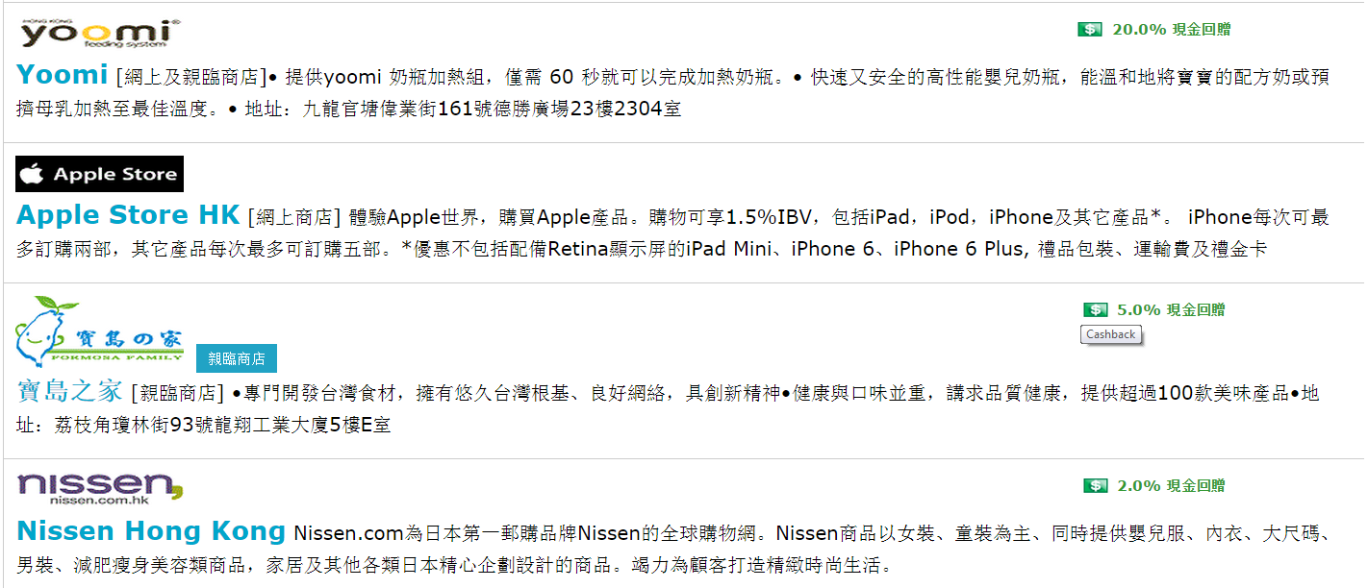

Slide 22
美安獨家代理品牌 – 2%現金回贈
美安夥伴商店 2% - 25%現金回贈
The MA Exclusive Brands: 2%Cashback
Partner Store: 2%-25% Cashback
現金回贈 Cashback:
每年 Annual$1,751.90
20 歲開始用美安產品:
Use MA products start from 20 years old :
$1,751.90 x 40年 = $70,076
現金回贈 Cashback:
每年Annual $4,140.00
20 歲開始用美安夥伴商店:Purchase in Partner Stores start from 20 years old :
$4,140.00x 40年 =$165,600.00
退休時估計累積Accumulated till retirement
$70,076 + $165,600 =$235,676.00

Slide 23
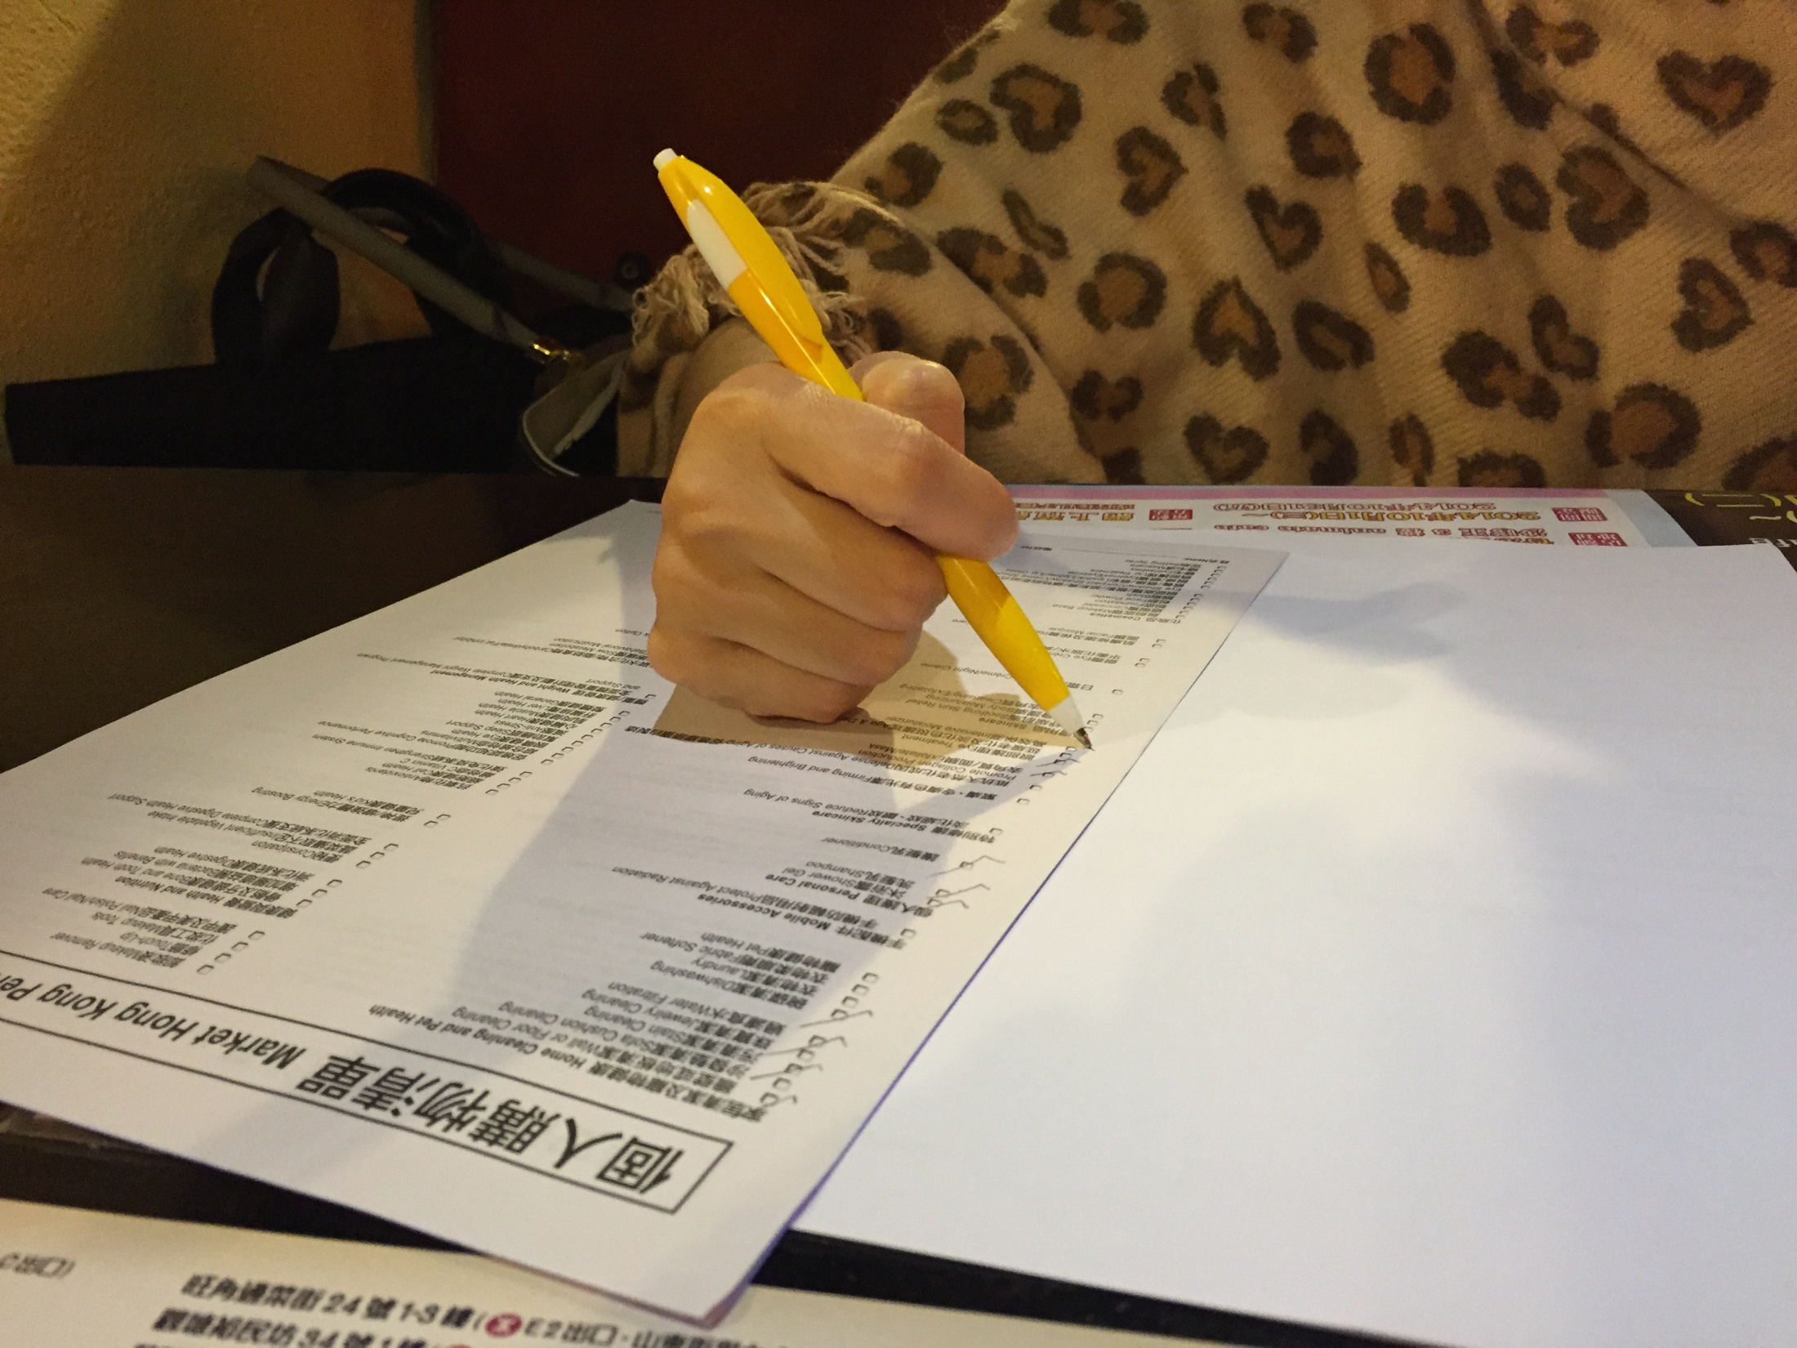
建立屬於自己的購物年金
Create your own Shopping Annuity

Slide 24
建立屬於自己的購物年金
Create your own Shopping Annuity
自動送貨=
優惠顧客將消費轉收入
AutoShip=Preferred Customer
Convert Spending Into Earning

Slide 25
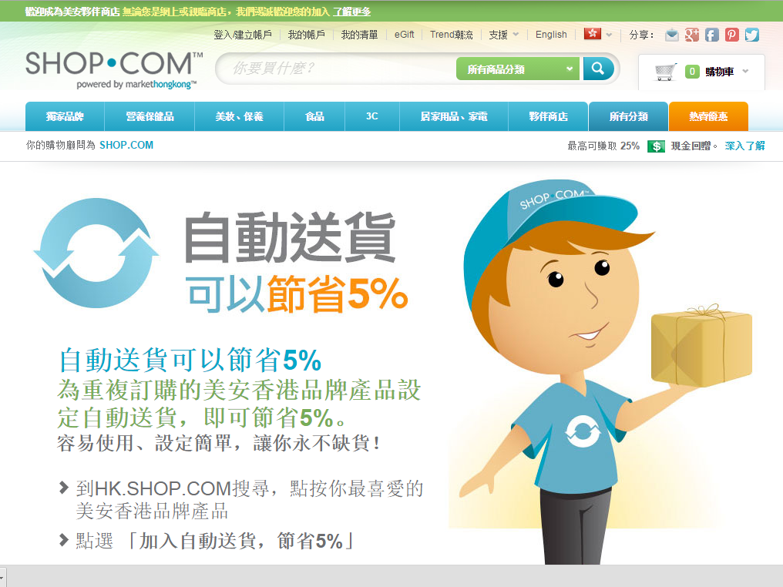
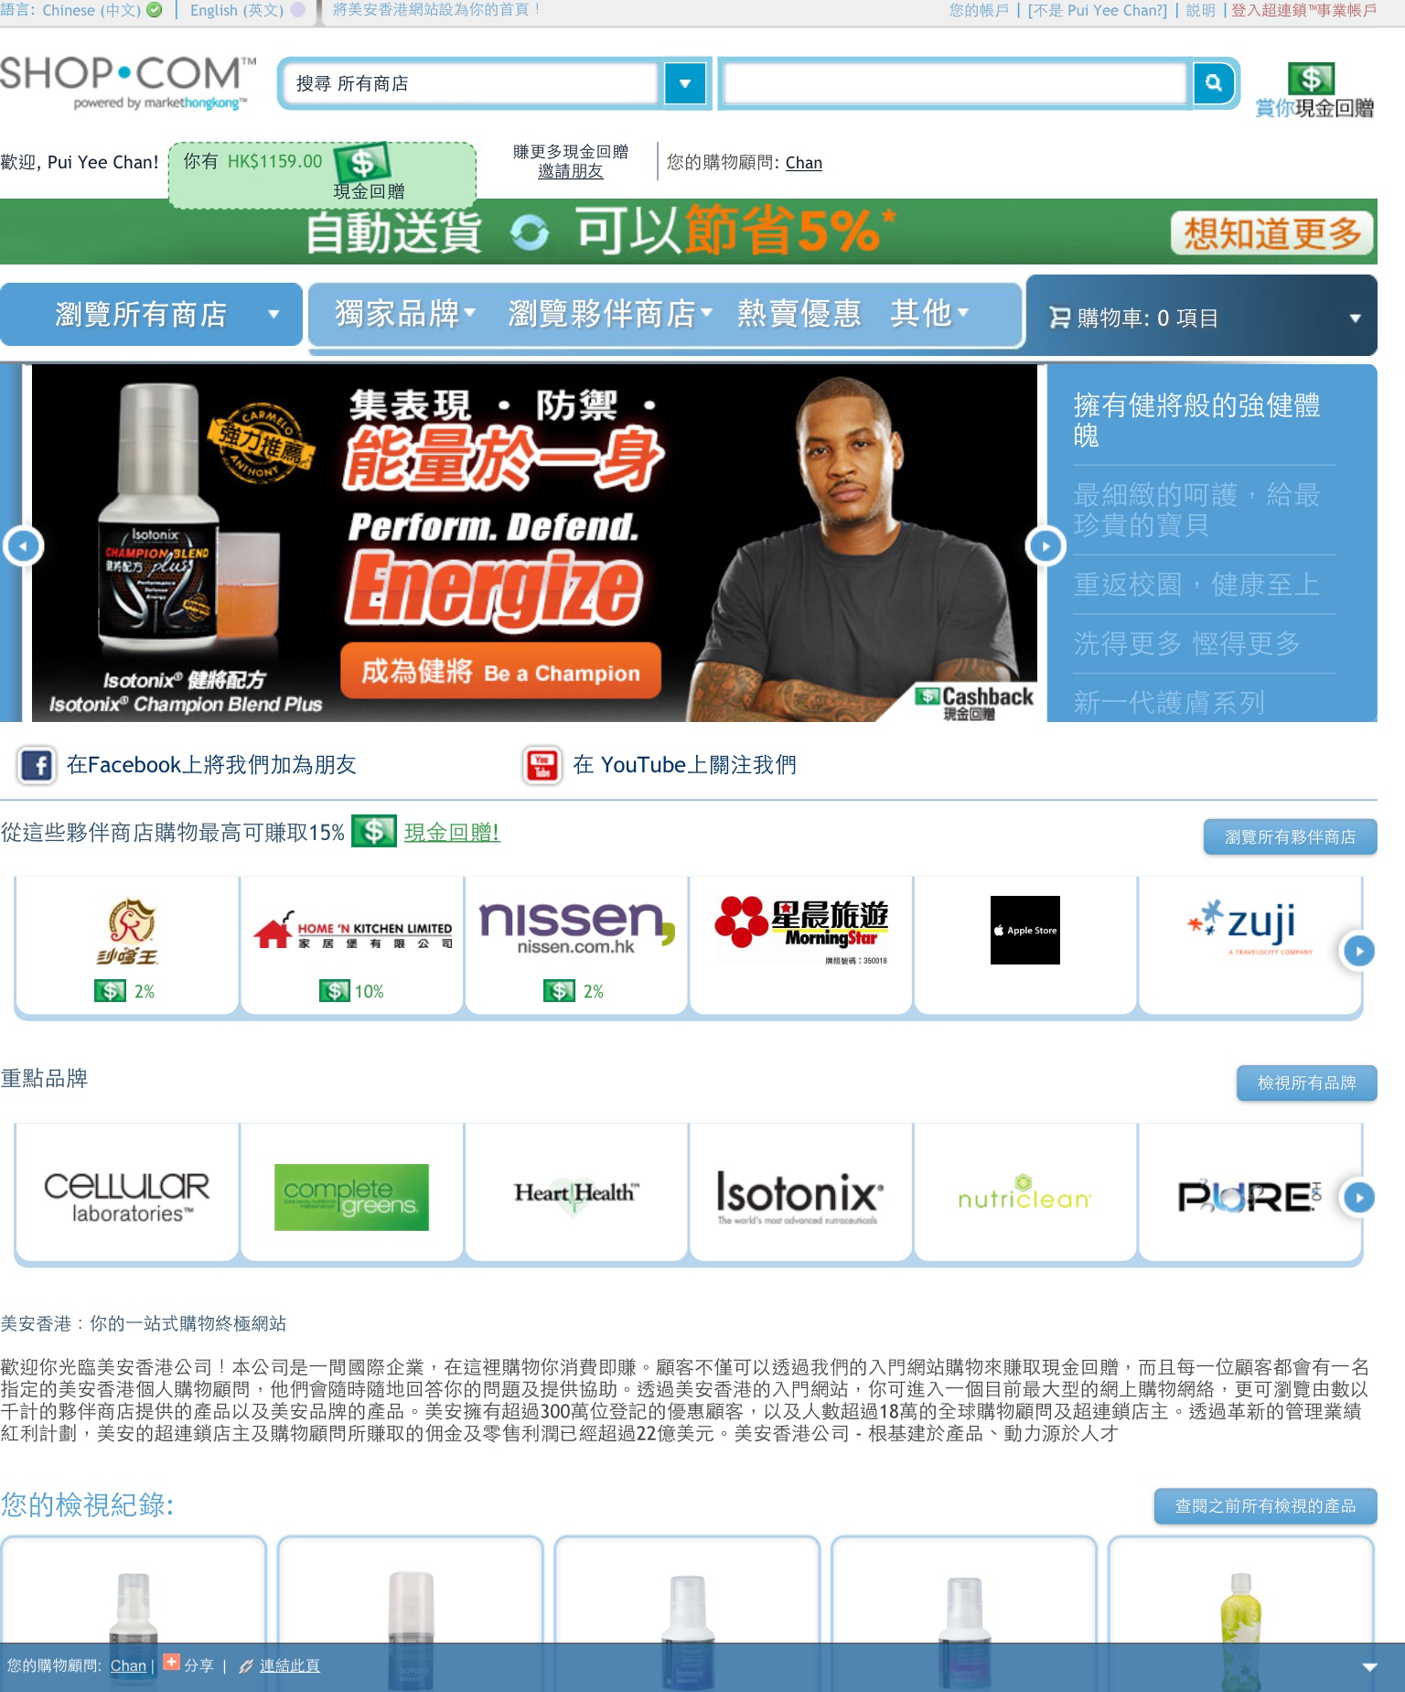

Slide 26
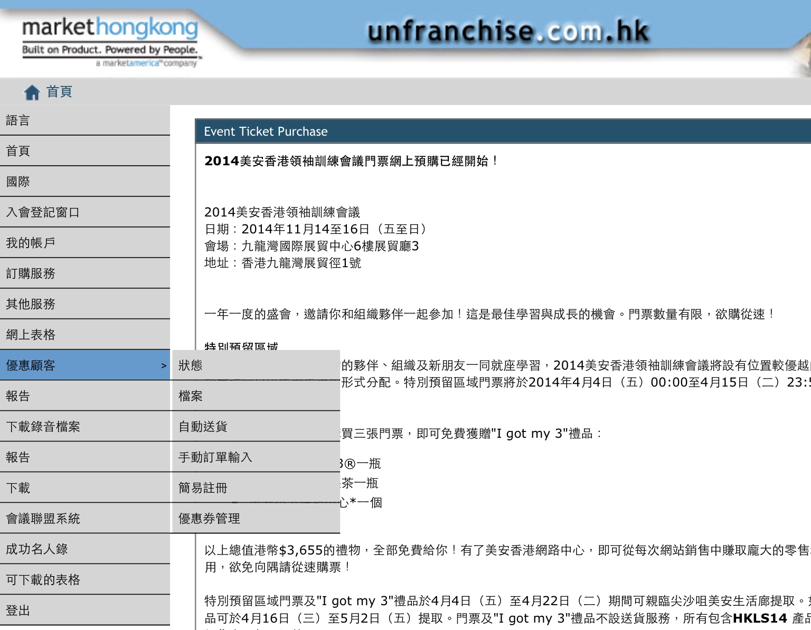

Slide 27
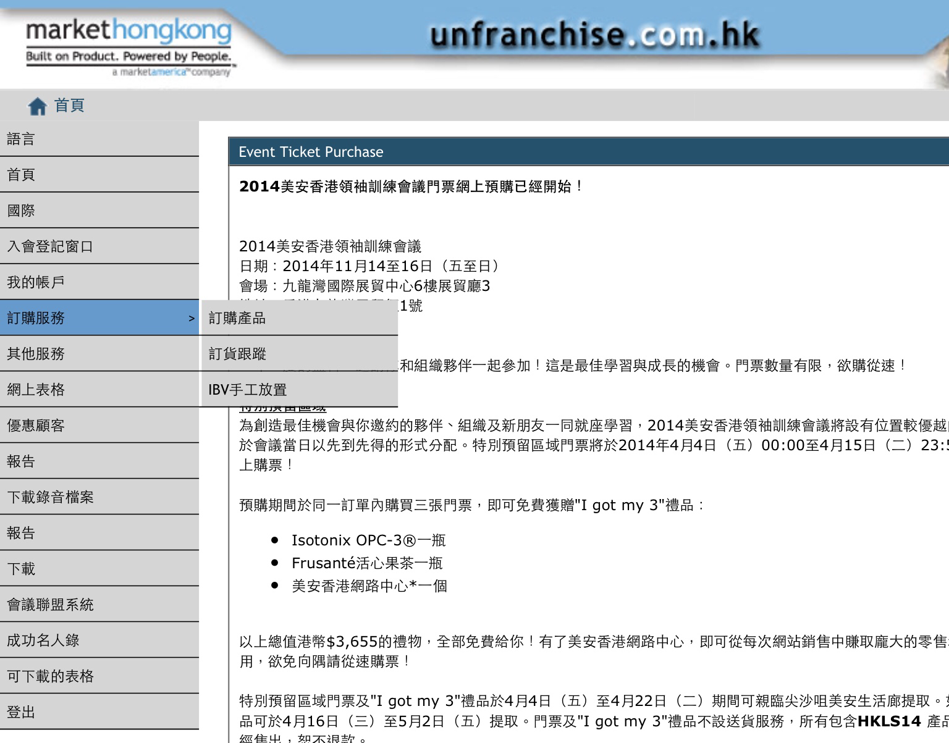

Slide 28
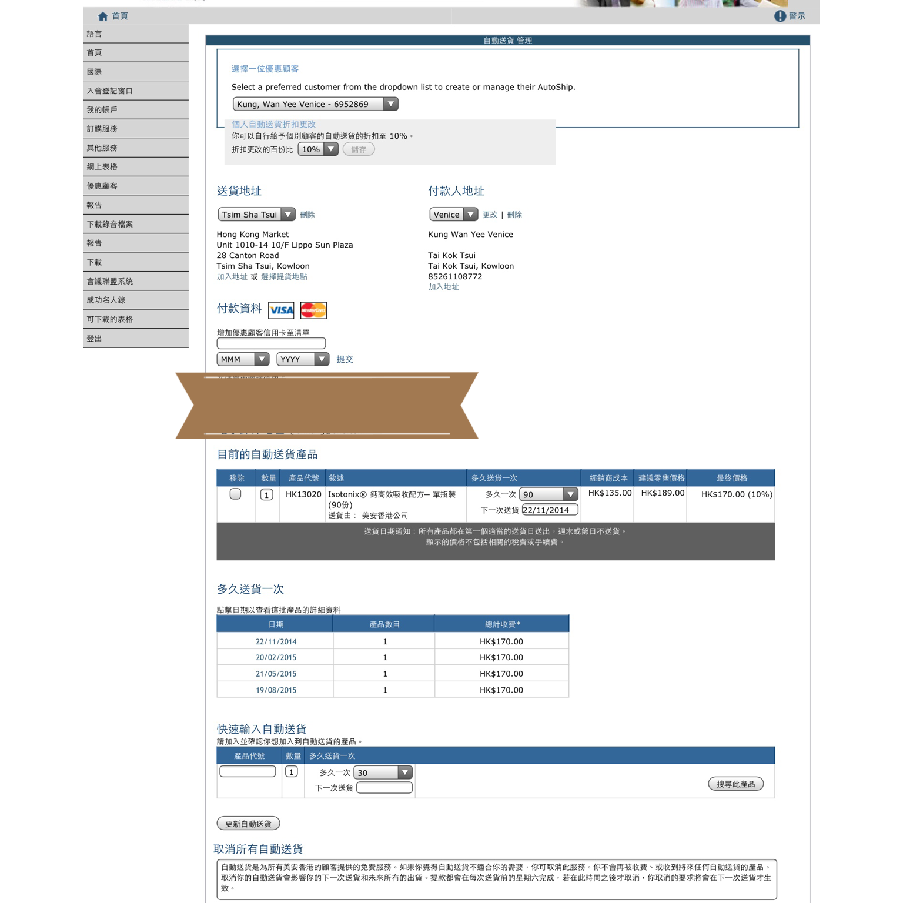

Slide 29
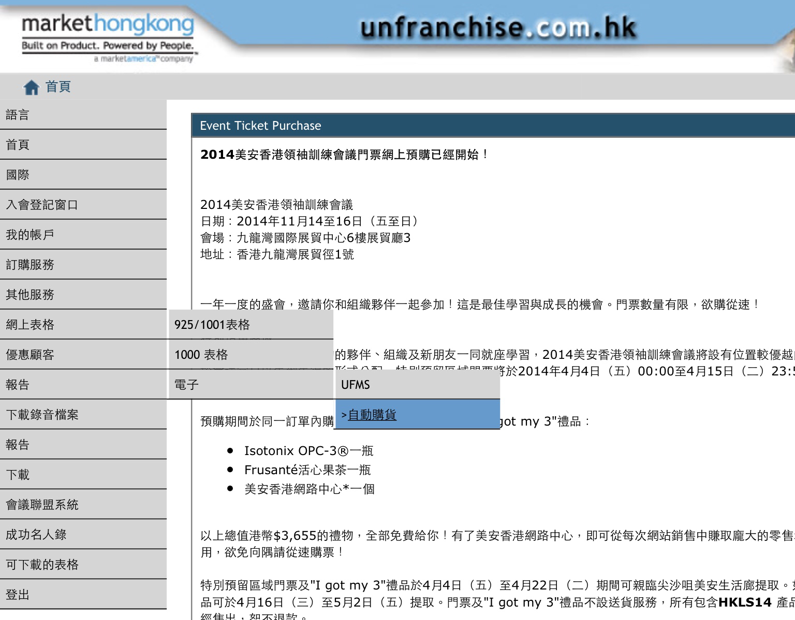

Slide 30
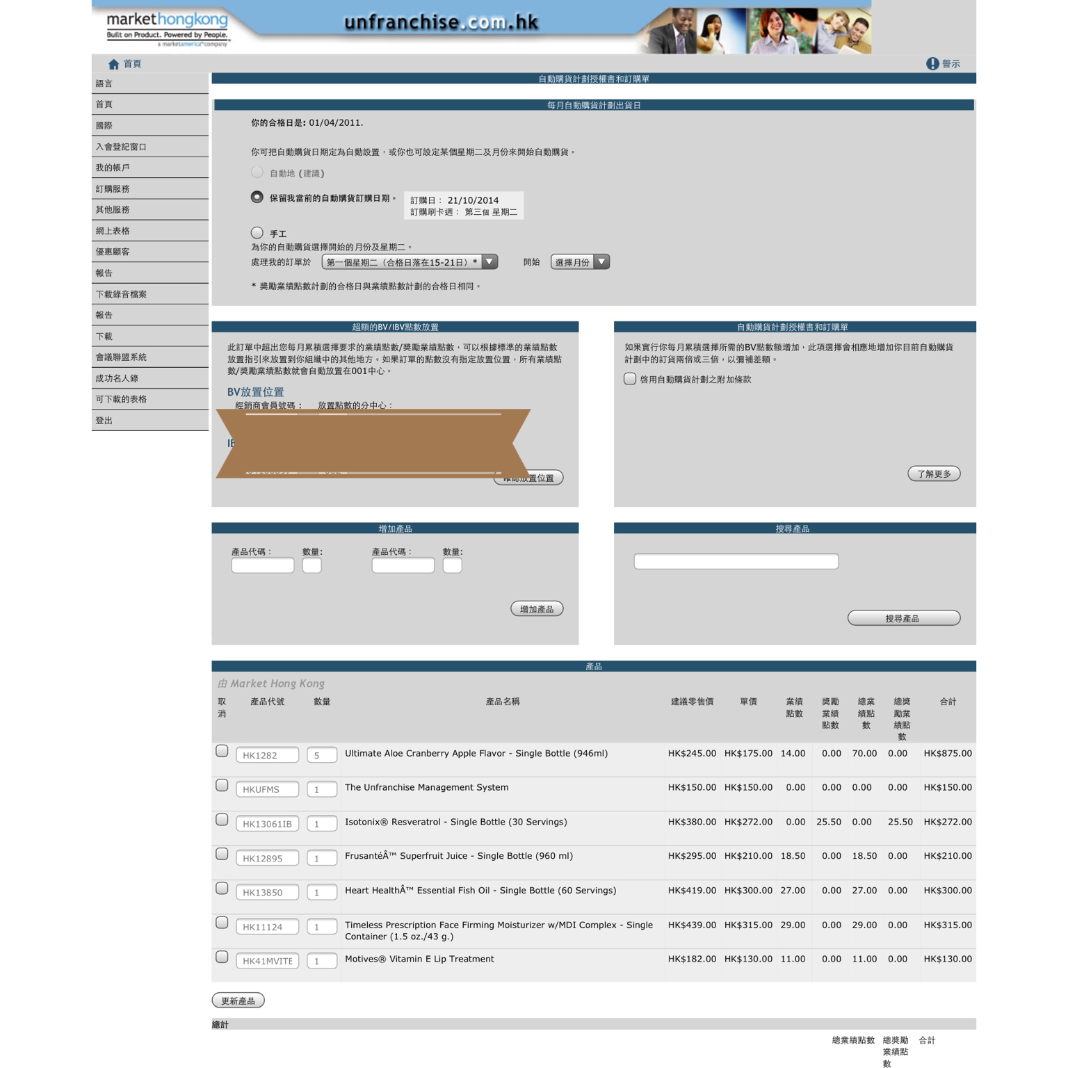

Slide 31
自動購貨=超連鎖™店主
自動送貨=優惠顧客
將消費轉收入
有效的複製，一切從自己開始！
Transfer Buying=UnFranchise™ Owner
AutoShip=Preferred Customer
Convert Spending Into Earning
Efficient replication, everything started
from your own!

Slide 34
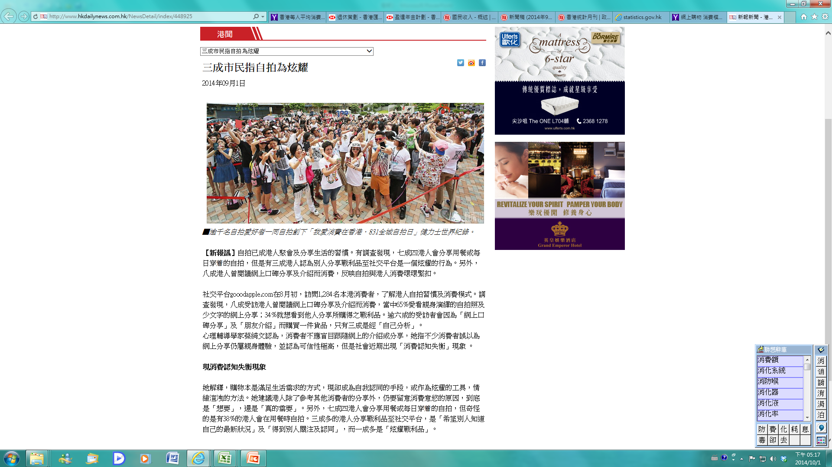

Slide 35
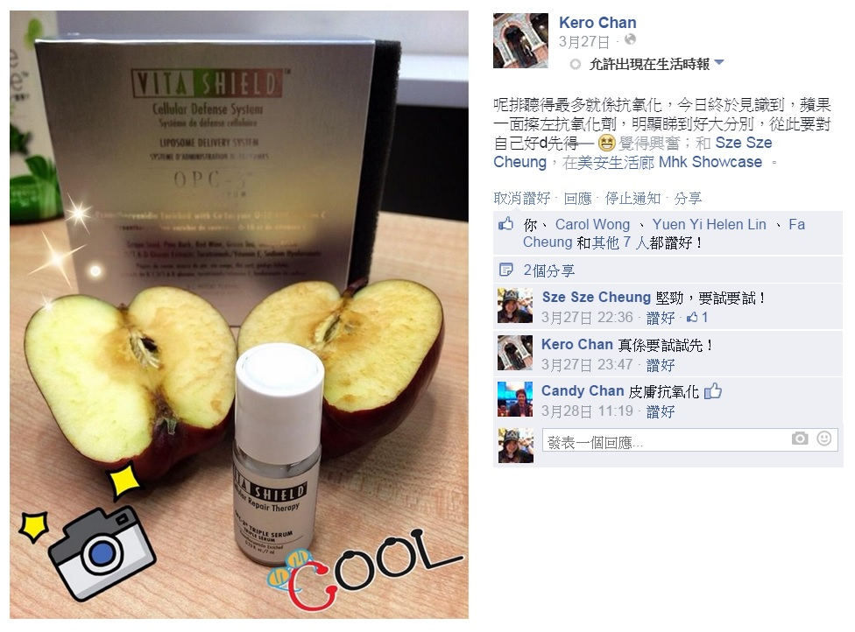

Slide 36
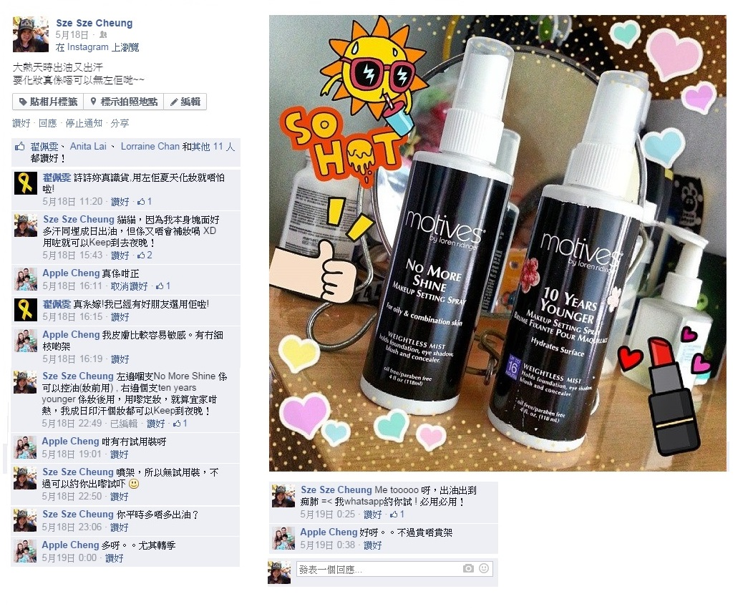

Slide 37
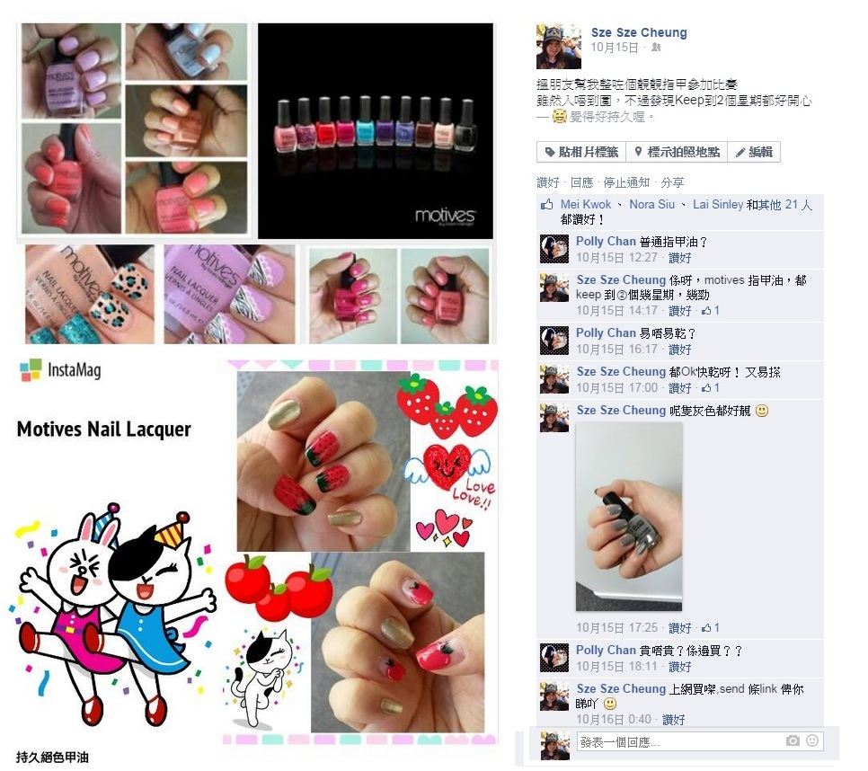

Slide 38
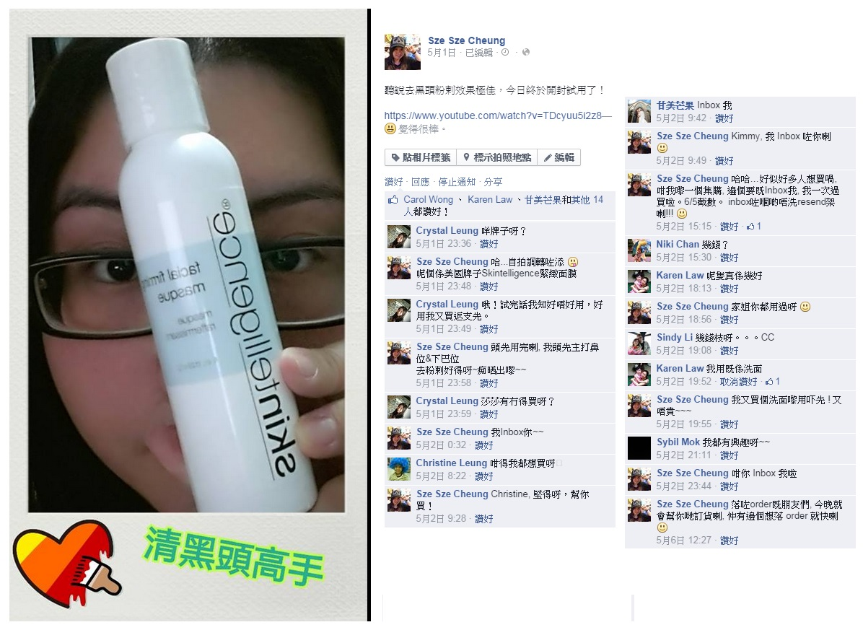

Slide 39
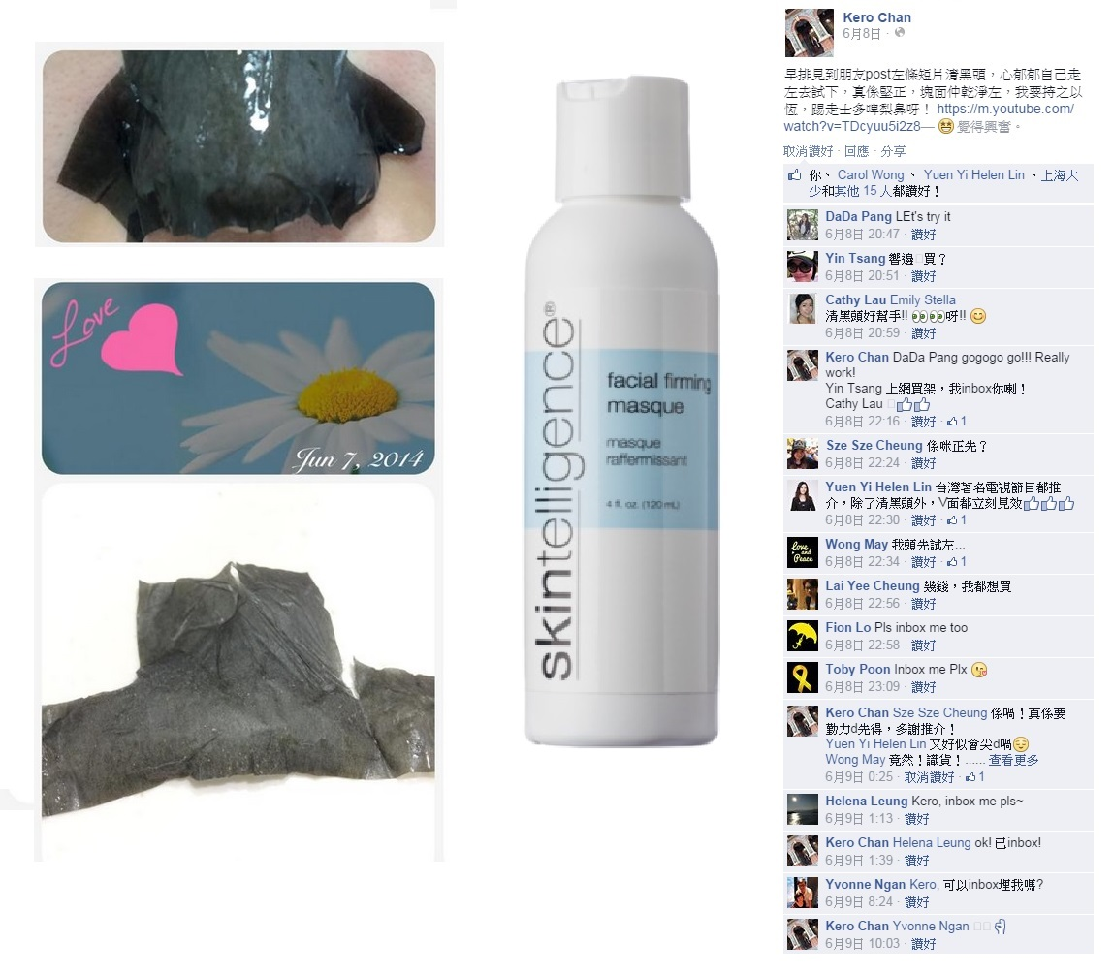

Slide 42
保險年金 vs 購物年金
Insurance VS Shopping Annuity
20歲開始供款:
Star the insurance from 20 years old:
每月供款: Monthly payments: $7,500
15yrs : $7,500 x 12 x 15 =
$1,350,000.00
入息期 15年Income period 15 yrs
每月存入Monthly deposit $10,400
入息期 : Income period :
$10,400 x 12 x 15 = $1,872,000.00

Slide 43
美安獨家代理品牌 – BV The MA Exclusive Brands - BV
例子1)家居及個人護理產品 Home and Garden and personal care products
例子2)健康營養補充品及濾水器 The health supplements and water filter
6.5 BV x 6 = 39BV
11 BV x 6 = 66BV
175 BV x 4 = 700BV
86 BV x 4 = 344BV
25 BV
65 BV x 6 = 260BV
45 BV x 6 = 270BV
27 BV x 6 = 162BV

Slide 44
20歲開始用美安獨家代理品:
Use MA products start from 20 years old:
Monthly consumption每月消費 $4,800 = 400BV/month
15yrs : $4,800 x 12 x 15 = $864,000.00
經營3年後After 3 years
Monthly commission每月佣金 $11,500 x 12 = $138,000.00
15yrs: $138,000 x 15 = $2,070,900.00

Slide 45
保險年金 vs 購物年金
保險年金
15年總供款:
$1,350,000.00
15年總入息: $1,872,000.00
購物年金
15年總消費
$864,000.00
15年總佣金: $2,070,900.00

Slide 46
轉消費為收入–「基本十顧客，七人強
Convert Spending Into Earning- ‘7 strong customers in ten’
三至六個月後，每月至少賺取$2300元
Earn at least $2300 a month after 3-6 months
c-
c-
c-
c-
c-
-c
-c
-c
-c
-c
1200 BV + 600 IBV
1200 BV + 600 IBV
400 BV＋200 IBV
c-
c-
c-
c-
c-
-c
-c
-c
-c
-c
c-
c-
c-
c-
c-
-c
-c
-c
-c
-c
400 BV＋200 IBV
400 BV＋200 IBV
c-
c-
c-
c-
c-
-c
-c
-c
-c
-c
c-
c-
c-
c-
c-
-c
-c
-c
-c
-c
c-
c-
c-
c-
c-
-c
-c
-c
-c
-c
c-
c-
c-
c-
c-
-c
-c
-c
-c
-c
400 BV＋200 IBV
400 BV＋200 IBV
400 BV＋200 IBV
400 BV＋200 IBV
兩至三年後，每月至少賺取$11,500元
Earn at least $11500 a month after 2-3 years

Slide 47
自動購貨=超連鎖™店主
自動送貨=優惠顧客
將消費轉收入
有效的複製，一切從自己開始！
Transfer Buying=UnFranchise™ Owner
AutoShip=Preferred Customer
Convert Spending Into Earning
Efficient replication, everything started
from your own!

